Slide 1
FARM TECH SYSYTEM
GROUP MEMBERS :-
VIVEK BHARDWAJ
MANDAVI UPADHYAYA
VIKAS SHROTIY
UNDER THE GUIDANCE OF :-
MR. MANDEEP SINGH
(TECHNICAL TRAINER)

Slide 2
CONTENTS
INTRODUCTION
OBJECTIVE OF FARM TECH SYSTEM
FUNCTIONALITIES OF FARM TECH SYSTEM
DFD
IMPLEMENTATION DETAILS
SCREEN SHOTS
ADVANTAGES
CONCLUSION

Slide 3
INTRODUCTION
The farm tech system software is a web application in java which perform the process of buying and selling of goods.
The system is implemented using a three tier approach with a backend database (MySQL, PhP). In frontend we are using Javascript , CSS,HTML.
This farm tech system is very easy to use.

Slide 4
OBJECTIVE OF FARM TECH SYSTEM
Add and Maintain records of available /new product
Add and maintain buyer and farmer details
Provide a convenient solution of buying and selling
Make an easy environment for buyer and farmer

Slide 5
FUNCTIONALITIES OF FARM TECH SYSTEM
There are three modules in our project –
Admin module
Farmer module
Buyer module
Admin module :
The admin has check all the operation in the program is going on.
Admin has right to change / re correct /delete all the operation .
Admin has right to delete any buyer or farmer details.

Slide 6
Continues…
Farmer module :
The farmer firstly register , then login in it .
The farmer add all the details of the crops and vegies.
The farmer set their product values .
Buyer module :
The buyer firstly register , then login in it .
The buyer can easily pick the product into the cart.
The buyer can easily pay the product price.

Slide 7
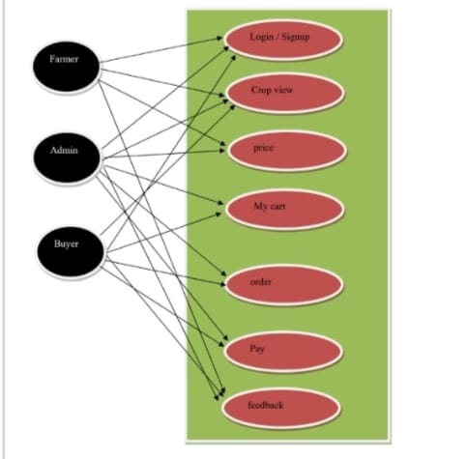
DIAGRAM

Slide 8
IMPLEMENTATION DETAILS
IDE - Visual Code Studio/Sublime
Javascript , CSS , html - For front end development
PhP, MySQL - For back end development
Xampp Server - For database

Slide 9
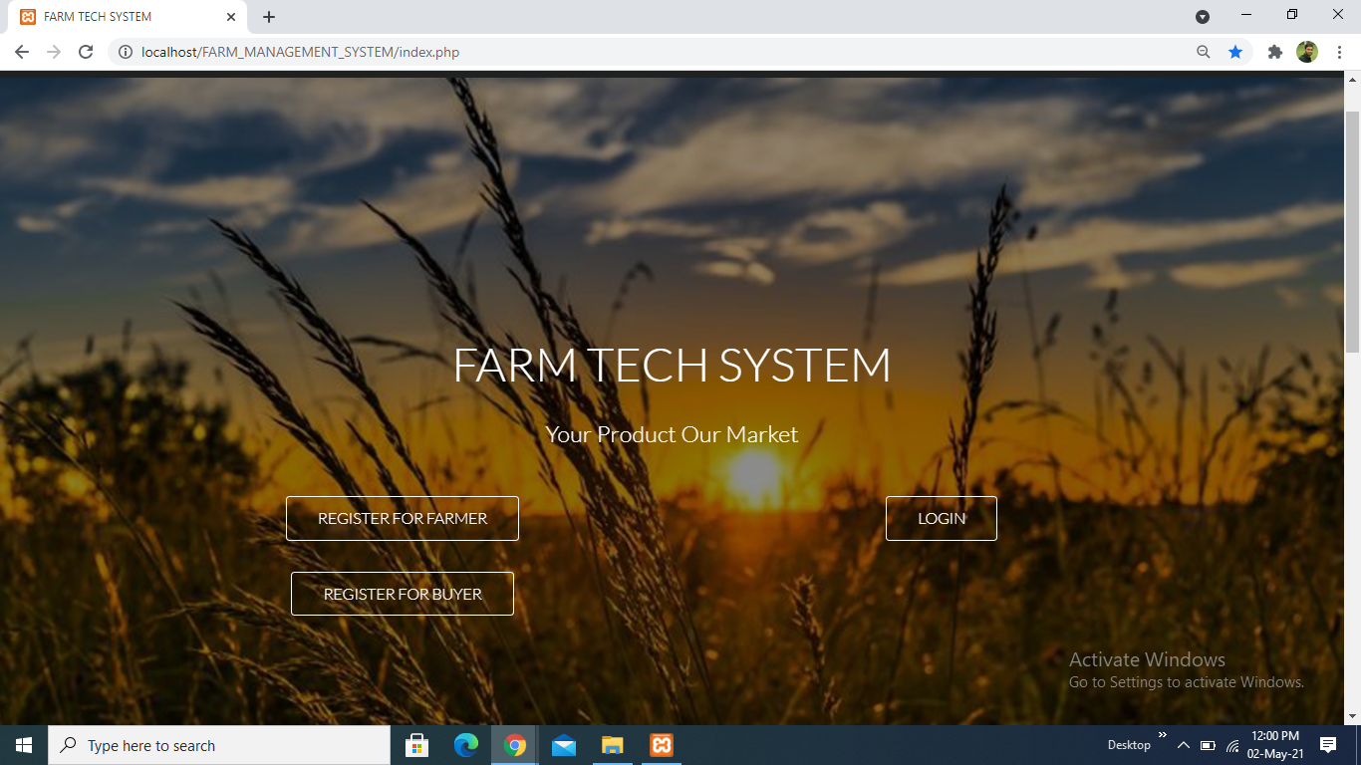
SCREEN SHOTS

Slide 10
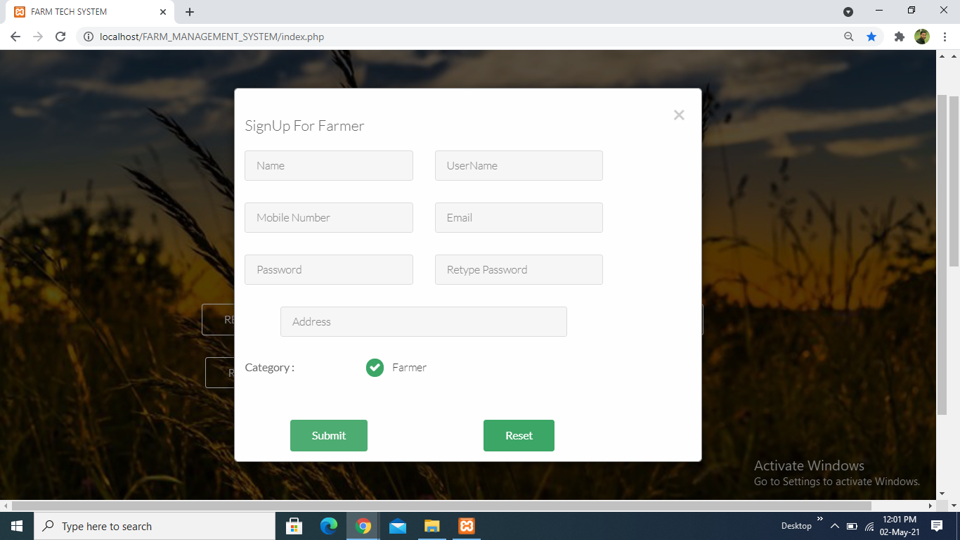

Slide 11
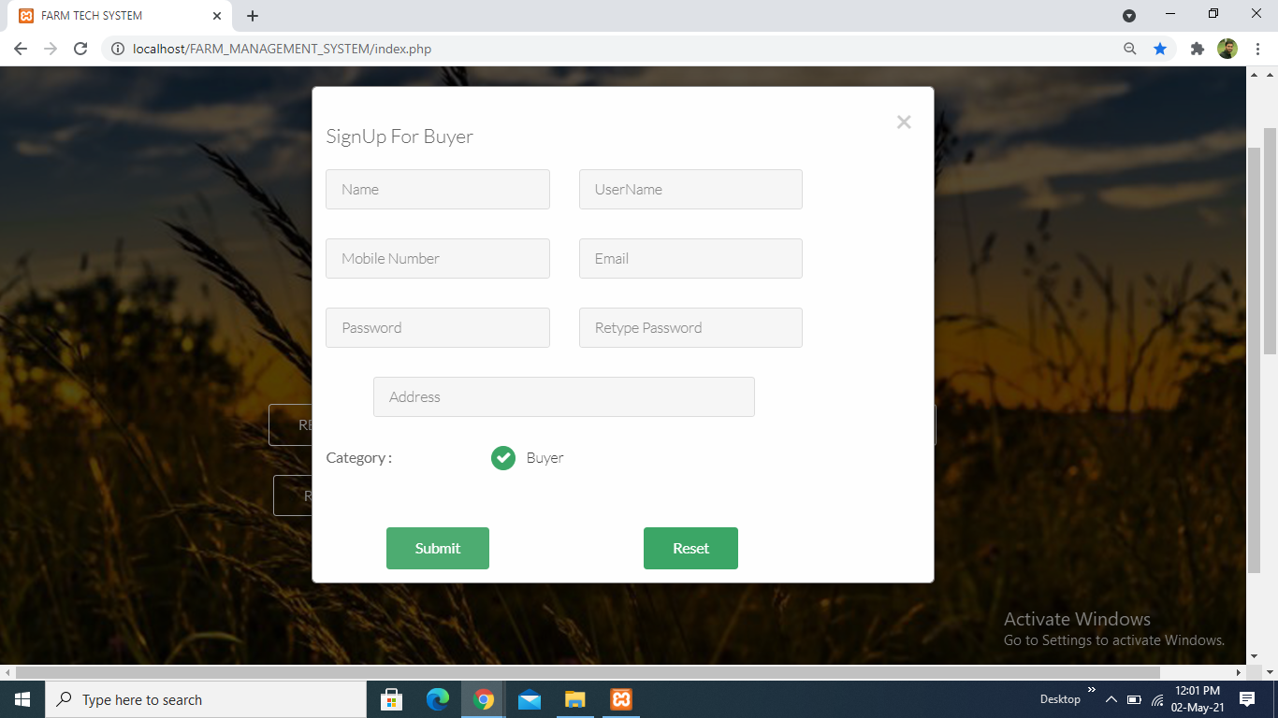

Slide 12
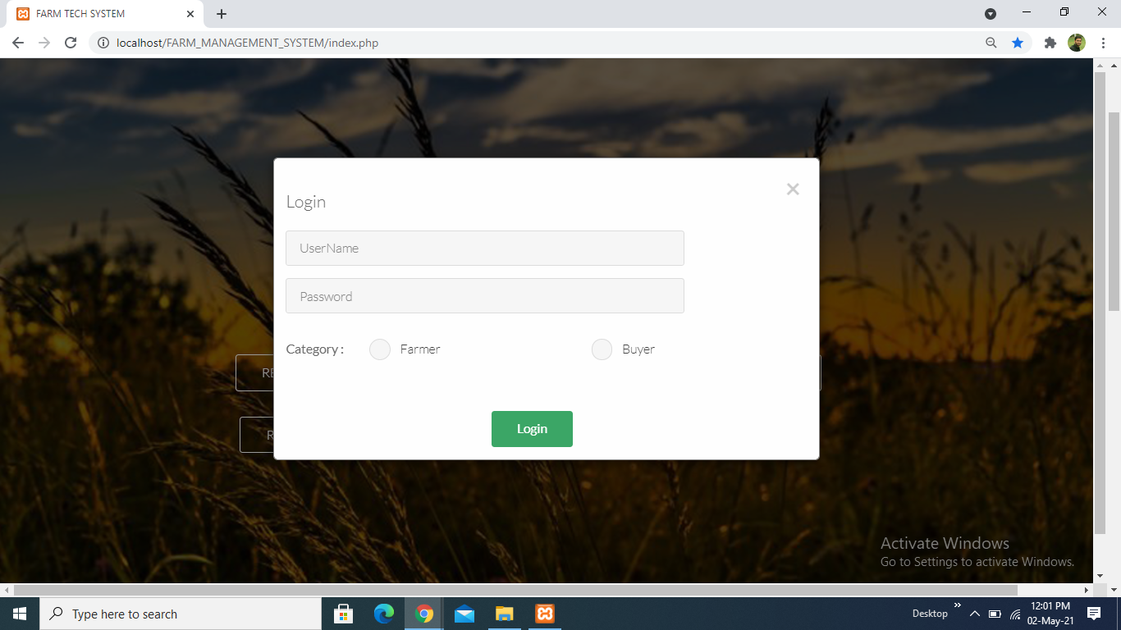

Slide 13
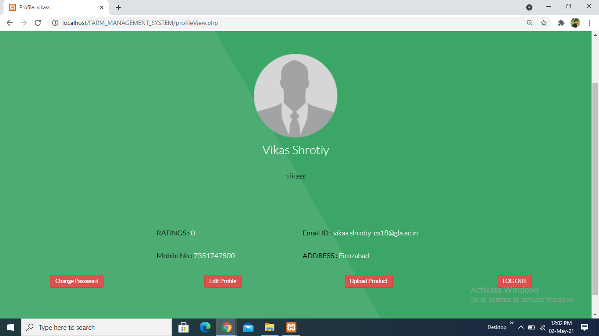

Slide 14
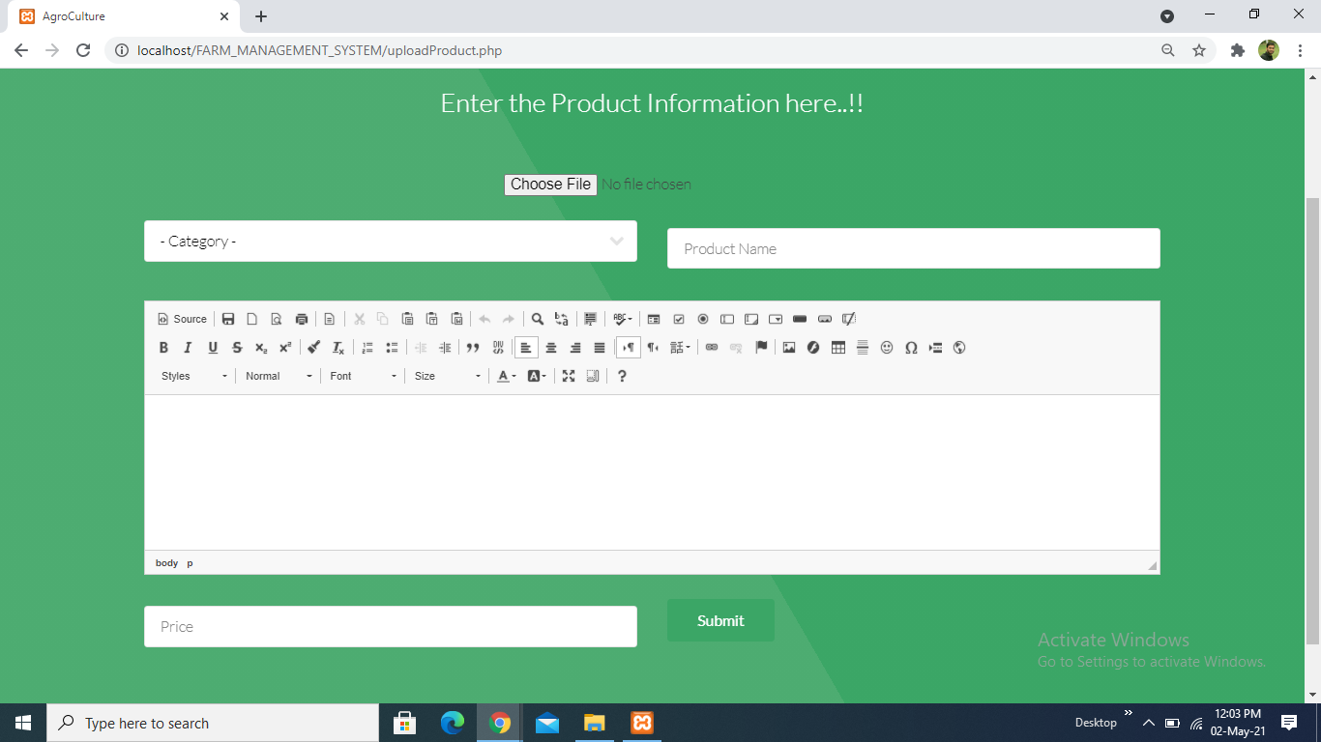

Slide 15
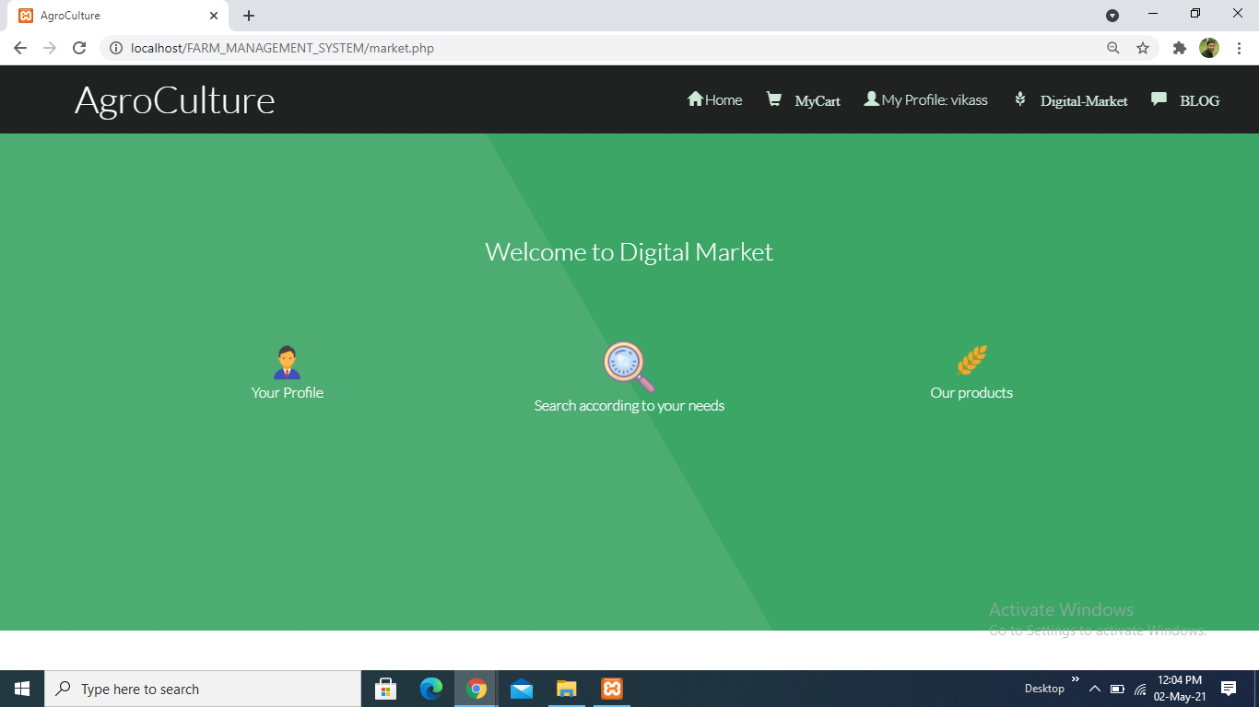

Slide 16
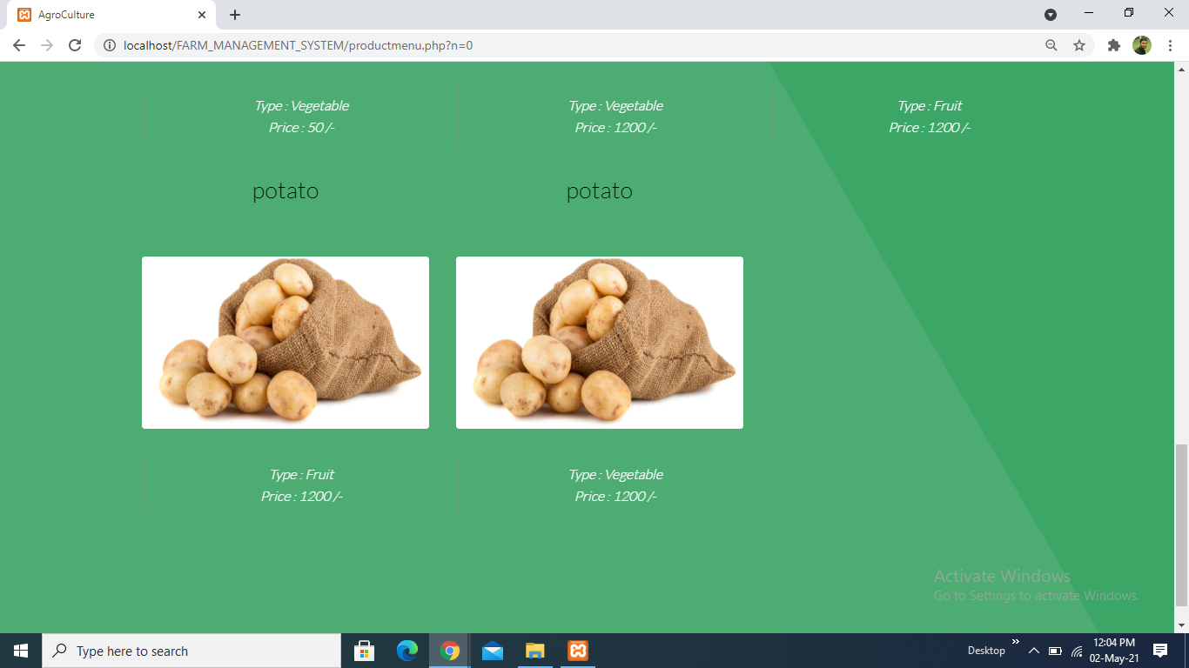

Slide 17
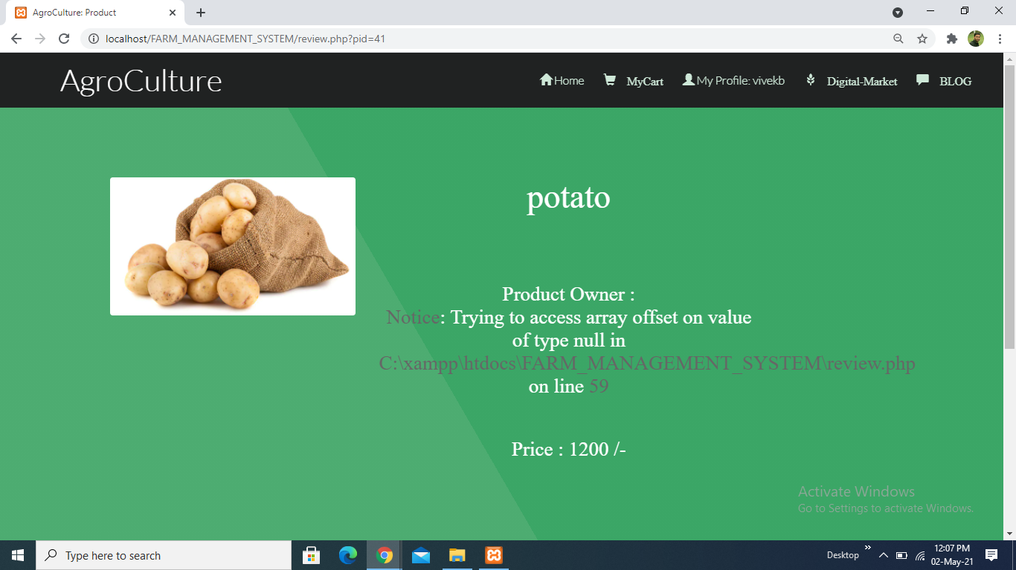

Slide 18
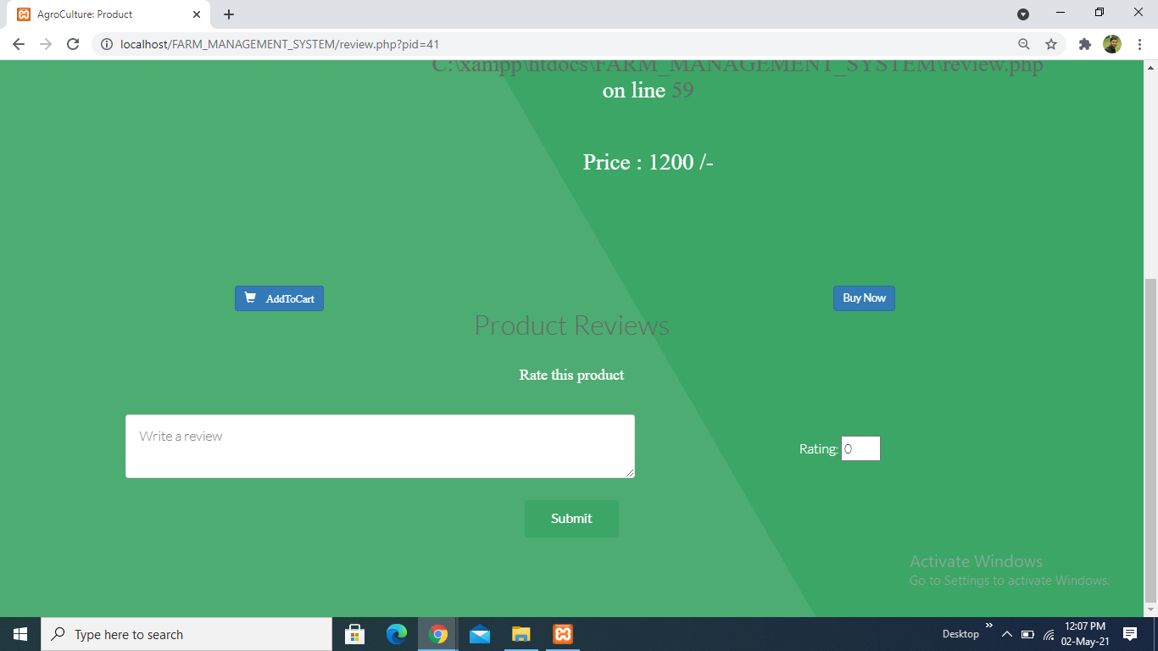

Slide 19
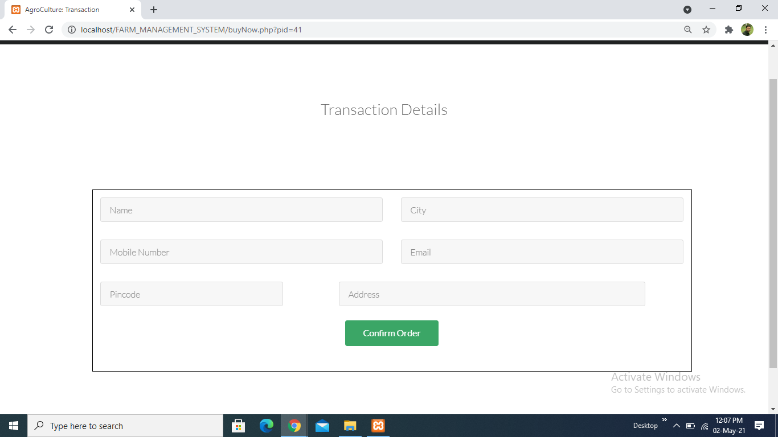

Slide 20
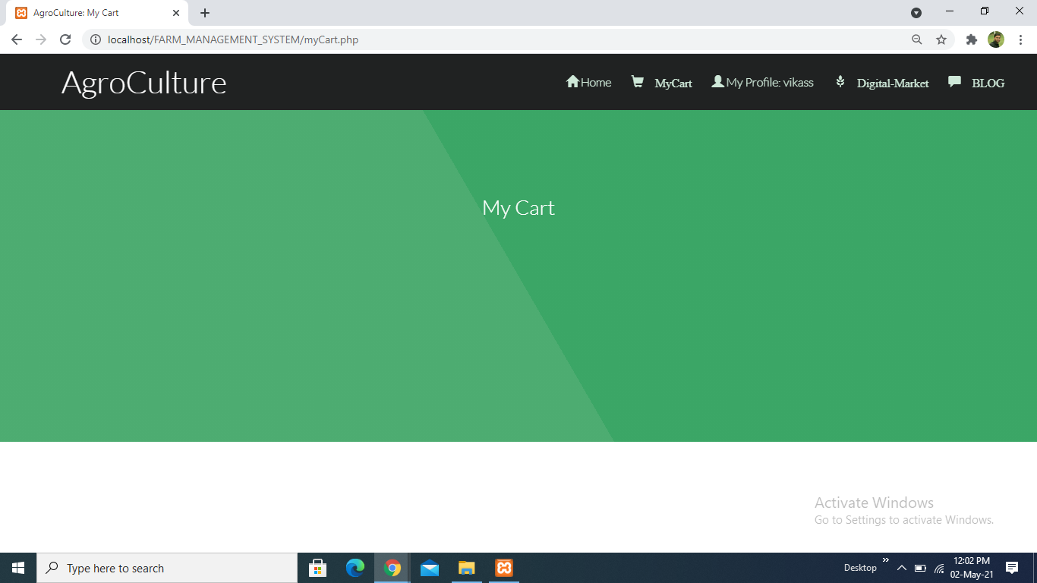

Slide 21
THANK YOU *_*

